Slide 1

Módulo 7
Ciclos

Slide 2
Loops

Slide 3
1
2
3
4
5
6
7
8
9
public class Loop5{
public static void main(String[] args){
System.out.println(1);
System.out.println(2);
System.out.println(3);
System.out.println(4);
System.out.println(5);
}
}
Design a program that prints the numbers from 1 to 5
1
2
3
4
5
6
7
8
9
10
11
12
13
14
public class Loop10{
public static void main(String[] args){
System.out.println(1);
System.out.println(2);
System.out.println(3);
System.out.println(4);
System.out.println(5);
System.out.println(6);
System.out.println(7);
System.out.println(8);
System.out.println(9);
System.out.println(10);
}
}
Design a program that prints the numbers from 1 to 10

Slide 4
1
2
3
4
5
6
7
8
9
public class Loop5{
public static void main(String[] args){
System.out.println(1);
System.out.println(2);
System.out.println(3);
System.out.println(4);
System.out.println(5);
}
}
1
2
3
4
5
6
7
8
9
10
11
12
13
14
public class Loop10{
public static void main(String[] args){
System.out.println(1);
System.out.println(2);
System.out.println(3);
System.out.println(4);
System.out.println(5);
System.out.println(6);
System.out.println(7);
System.out.println(8);
System.out.println(9);
System.out.println(10);
}
}
Now one that prints the numbers from 1 to 100
public class Loop5{
public static void main(String[] args){
System.out.println(1);
System.out.println(2);
System.out.println(3);
System.out.println(4);
System.out.println(5);
System.out.println(6);
System.out.println(7);
System.out.println(8);
System.out.println(9);
System.out.println(10);
System.out.println(11);
System.out.println(12);
System.out.println(13);
System.out.println(14);
System.out.println(15);
System.out.println(16);
System.out.println(17);
System.out.println(18);
System.out.println(19);
System.out.println(20);
System.out.println(21);
System.out.println(22);
System.out.println(23);
System.out.println(24);
System.out.println(25);
System.out.println(26);
System.out.println(27);
}
}

Slide 5

1
2
3
4
5
6
7
8
9
10
11
12
13
14
public class Loop10{
public static void main(String[] args){
System.out.println(1);
System.out.println(2);
System.out.println(3);
System.out.println(4);
System.out.println(5);
System.out.println(6);
System.out.println(7);
System.out.println(8);
System.out.println(9);
System.out.println(10);
}
}
1
2
3
4
5
6
7
8
9
public class Loop5{
public static void main(String[] args){
System.out.println(1);
System.out.println(2);
System.out.println(3);
System.out.println(4);
System.out.println(5);
}
}
public class Loop100{
public static void main(String[] args){
System.out.println(1);
System.out.println(2);
System.out.println(3);
System.out.println(4);
System.out.println(5);
System.out.println(6);
System.out.println(7);
System.out.println(8);
System.out.println(9);
System.out.println(10);
System.out.println(11);
System.out.println(12);
System.out.println(13);
System.out.println(14);
System.out.println(15);
System.out.println(16);
System.out.println(17);
System.out.println(18);
System.out.println(19);
System.out.println(20);
System.out.println(21);
System.out.println(22);
System.out.println(23);
System.out.println(24);
System.out.println(25);
System.out.println(26);
System.out.println(27);
}
}
Now one that prints the numbers from 1 to 100

Slide 6
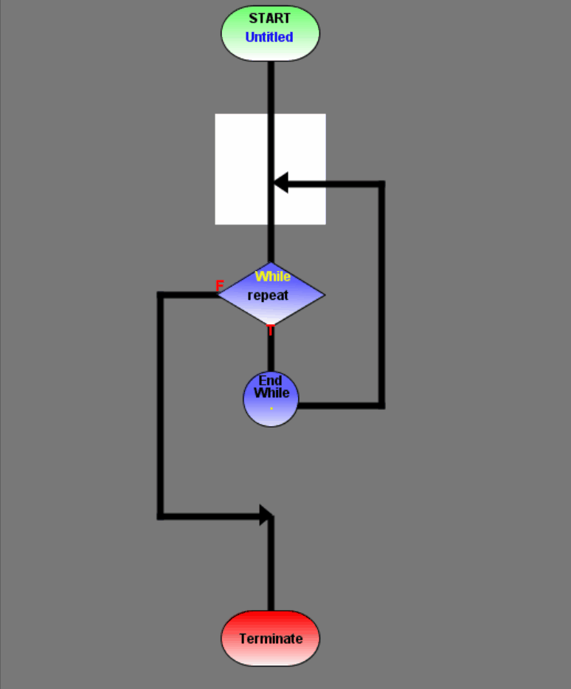

Computers are great at repeating instructions!

Slide 7
Loops
A block of instructions that will repeat based on a boolean expression.
Loop body: Code to be repeated
Control variable: Variable that will control
Exit condition: When will the block of code stop repeating?

Slide 8
While loops

Slide 9
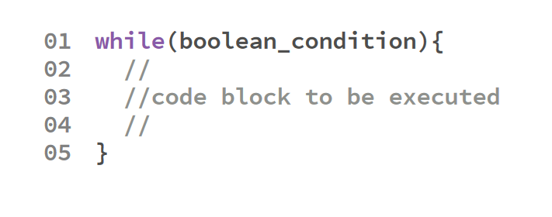
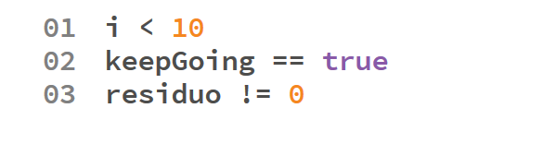
Sintaxis
Examples of conditions

Slide 10
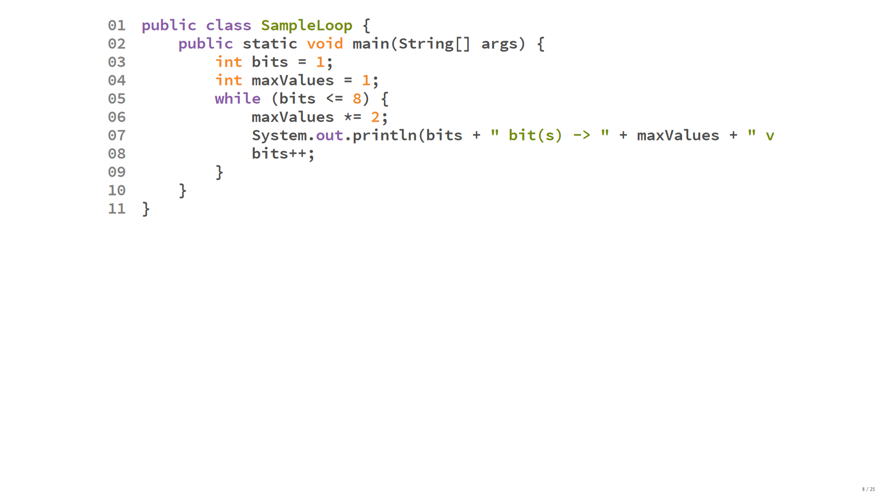

Slide 11
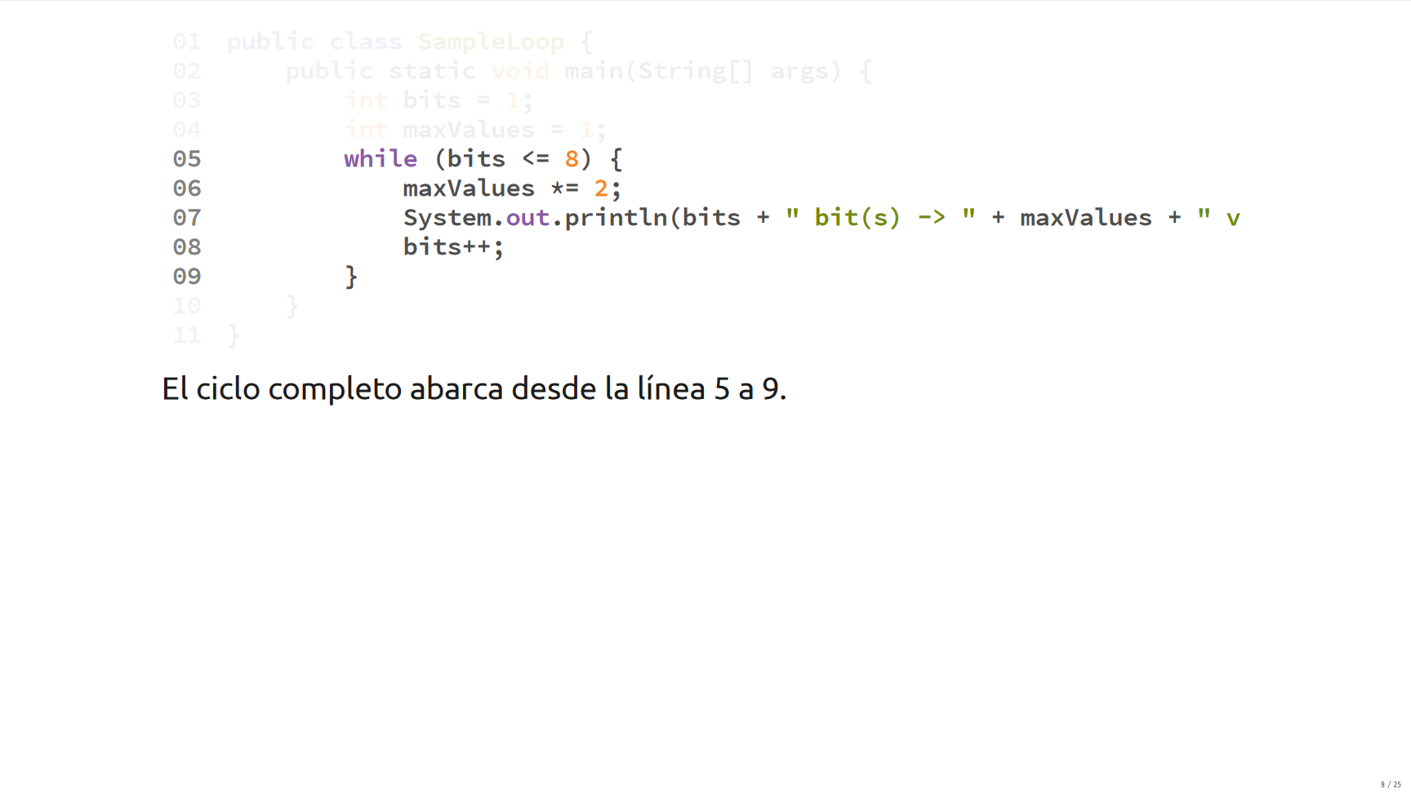

Slide 12
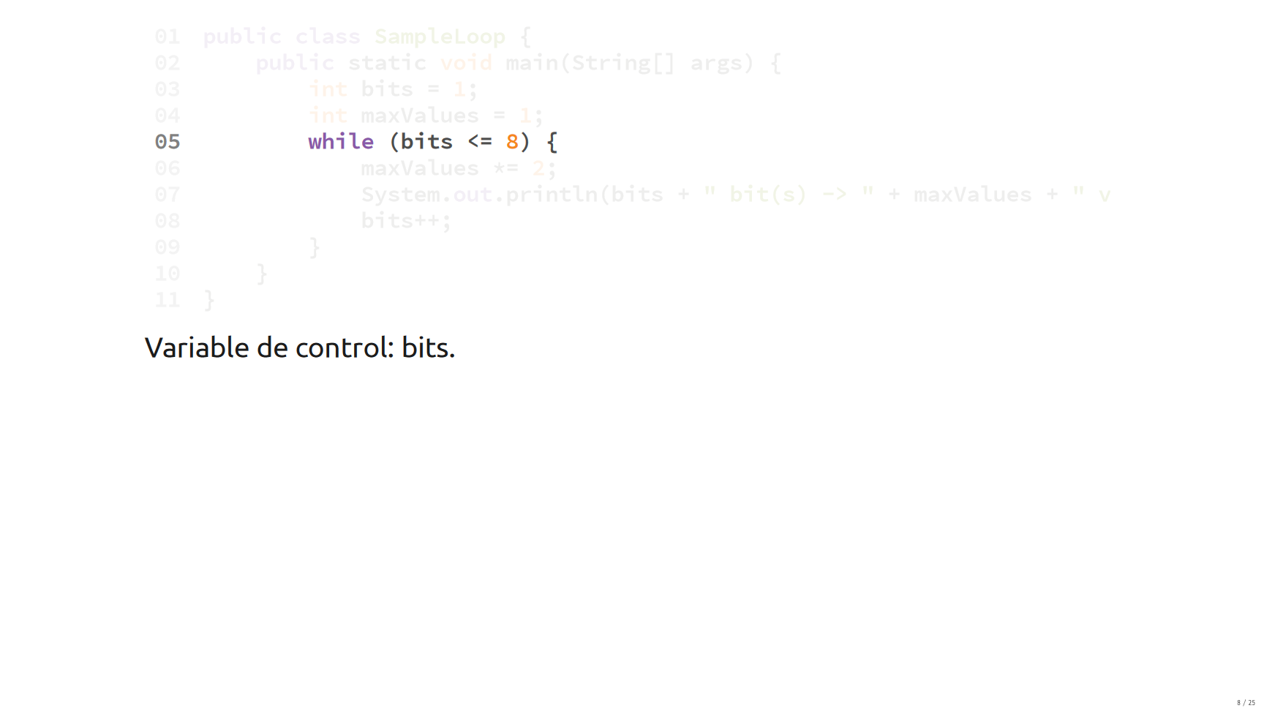

Slide 13
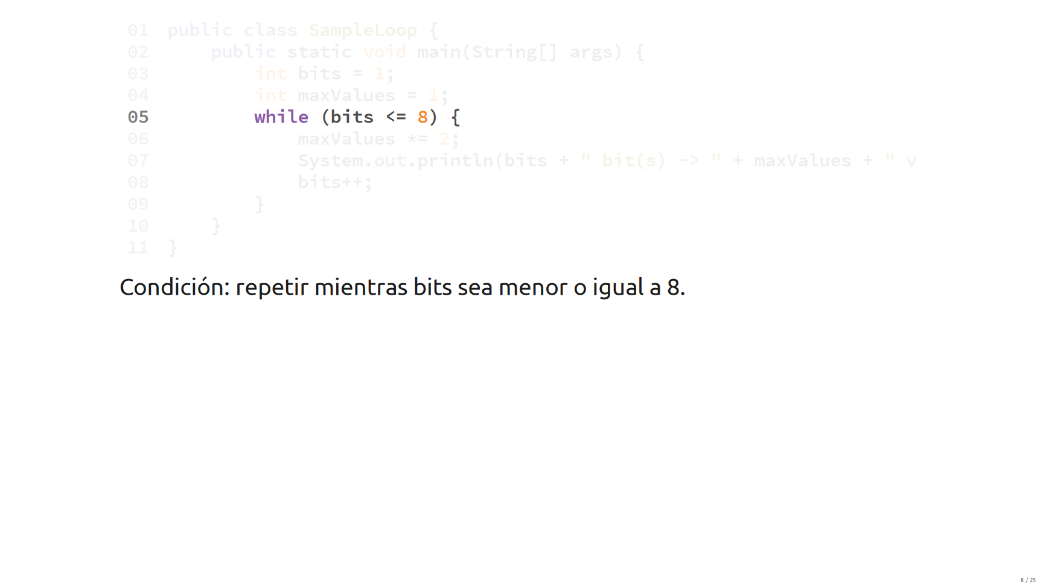

Slide 14
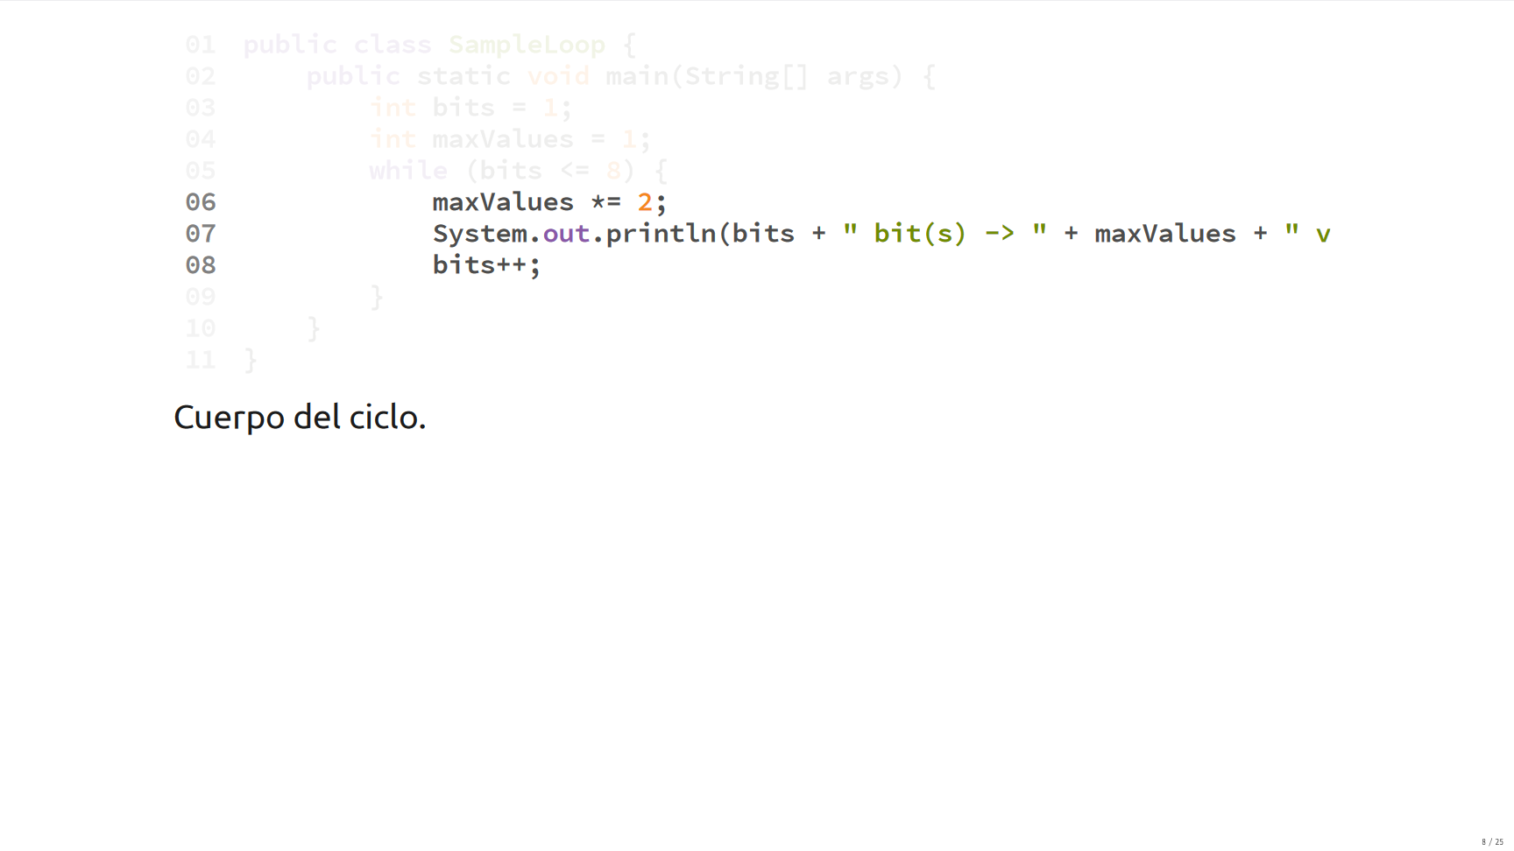

Slide 15
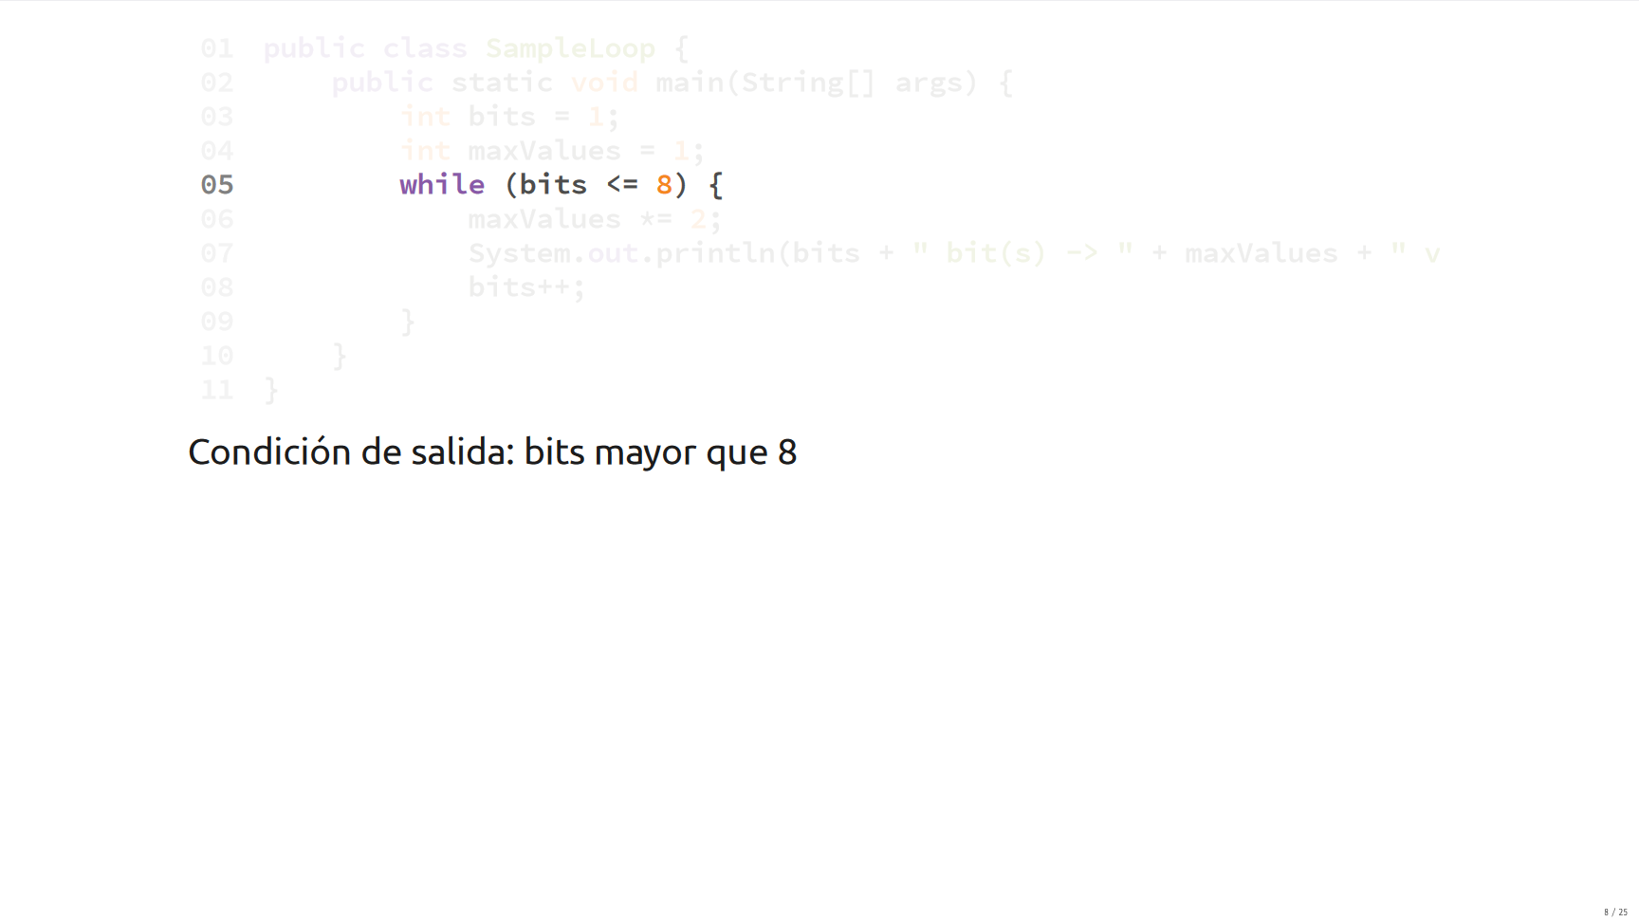

Slide 16
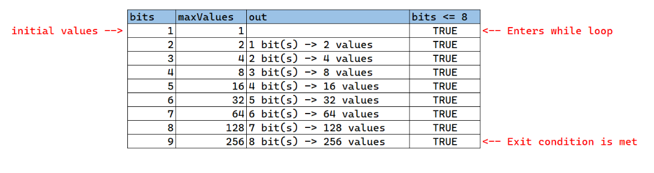
Code trace

Slide 17
Do-while

Slide 18
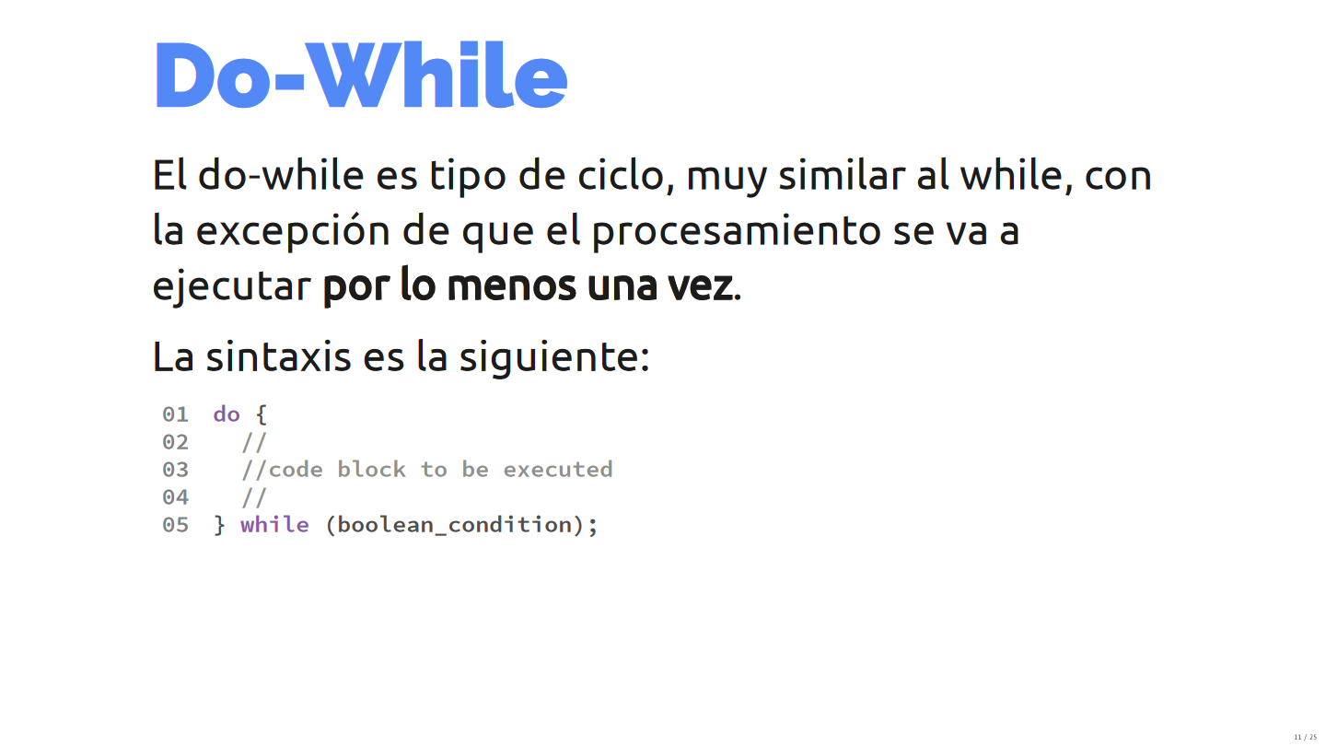

Slide 19
Do-whiles are very similar to whiles, with the exception that it will always be executed at least once.
This is because the Boolean condition is evaluated at the end of the loop, instead of at the start. This loops are very useful when validating inputs from the keyboard.

Slide 20
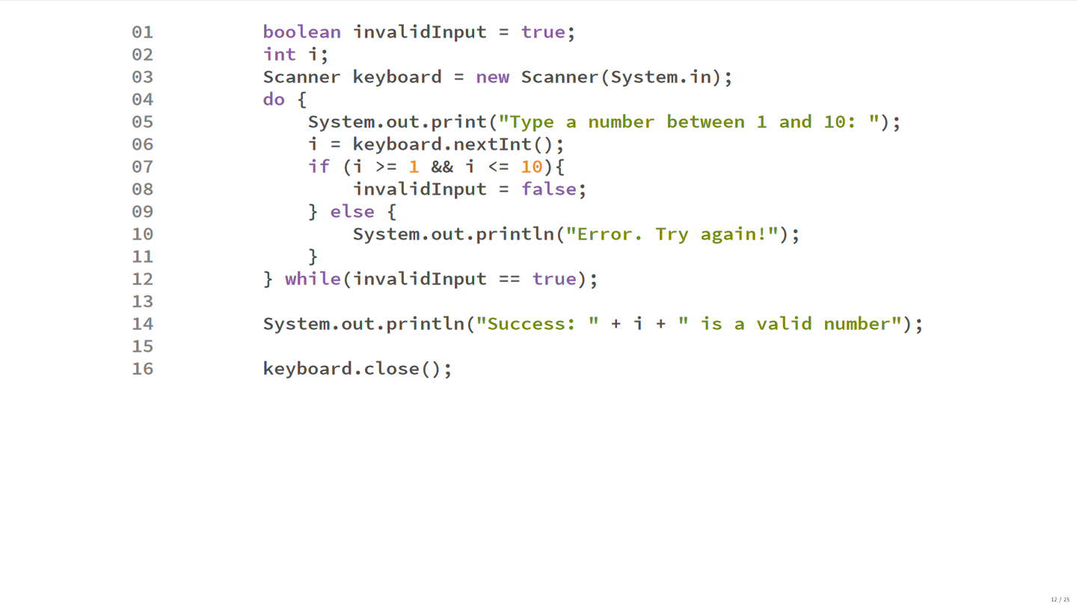

Slide 21
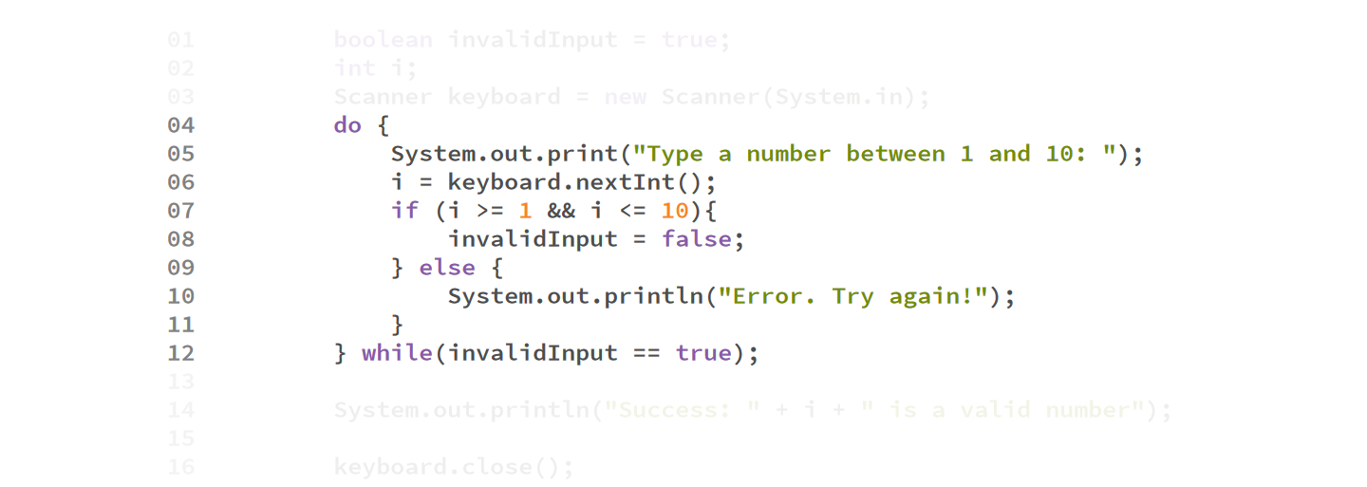

Slide 22
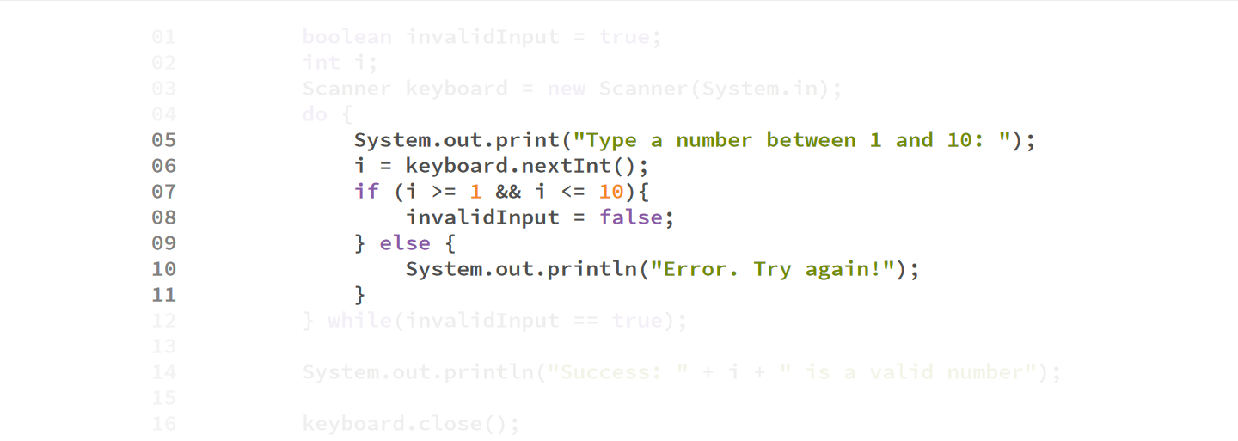

Slide 23
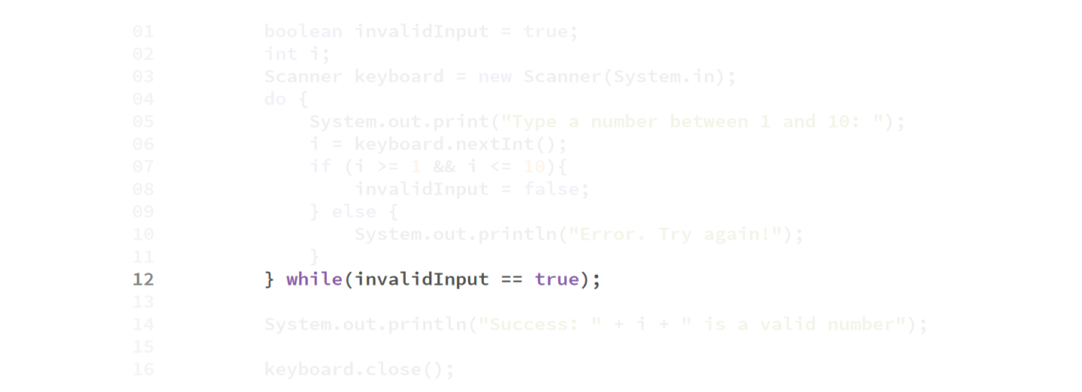

Slide 24
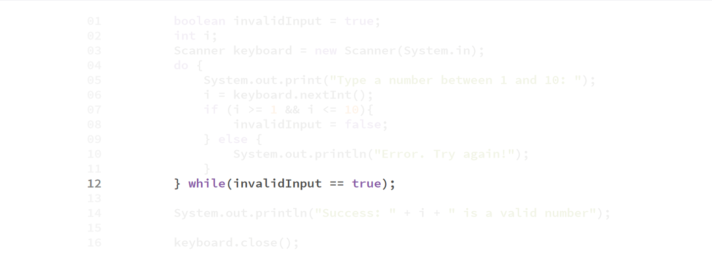

Slide 25
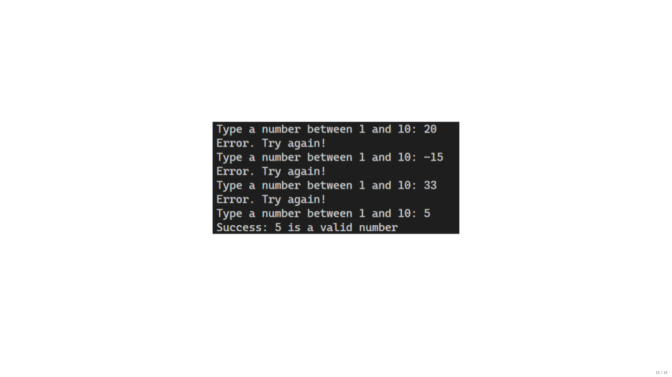

Slide 26
For loop

Slide 27
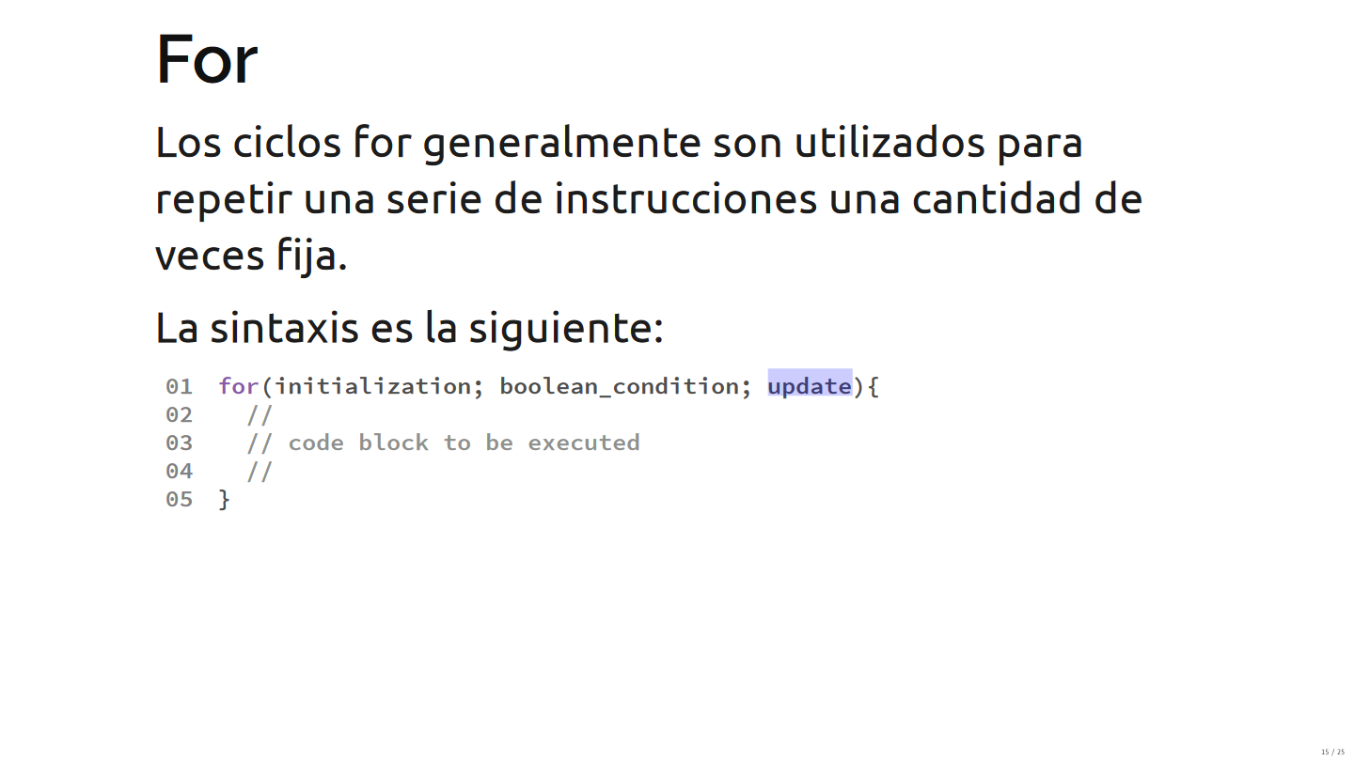

Slide 28
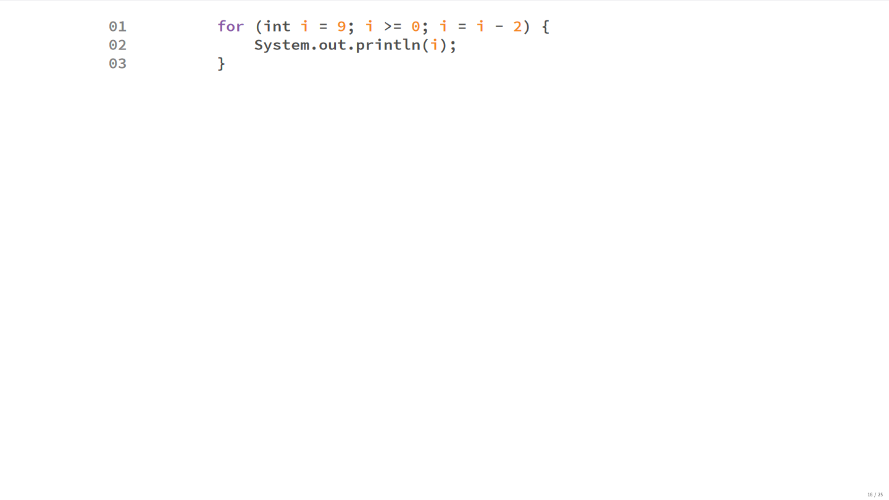

Slide 29
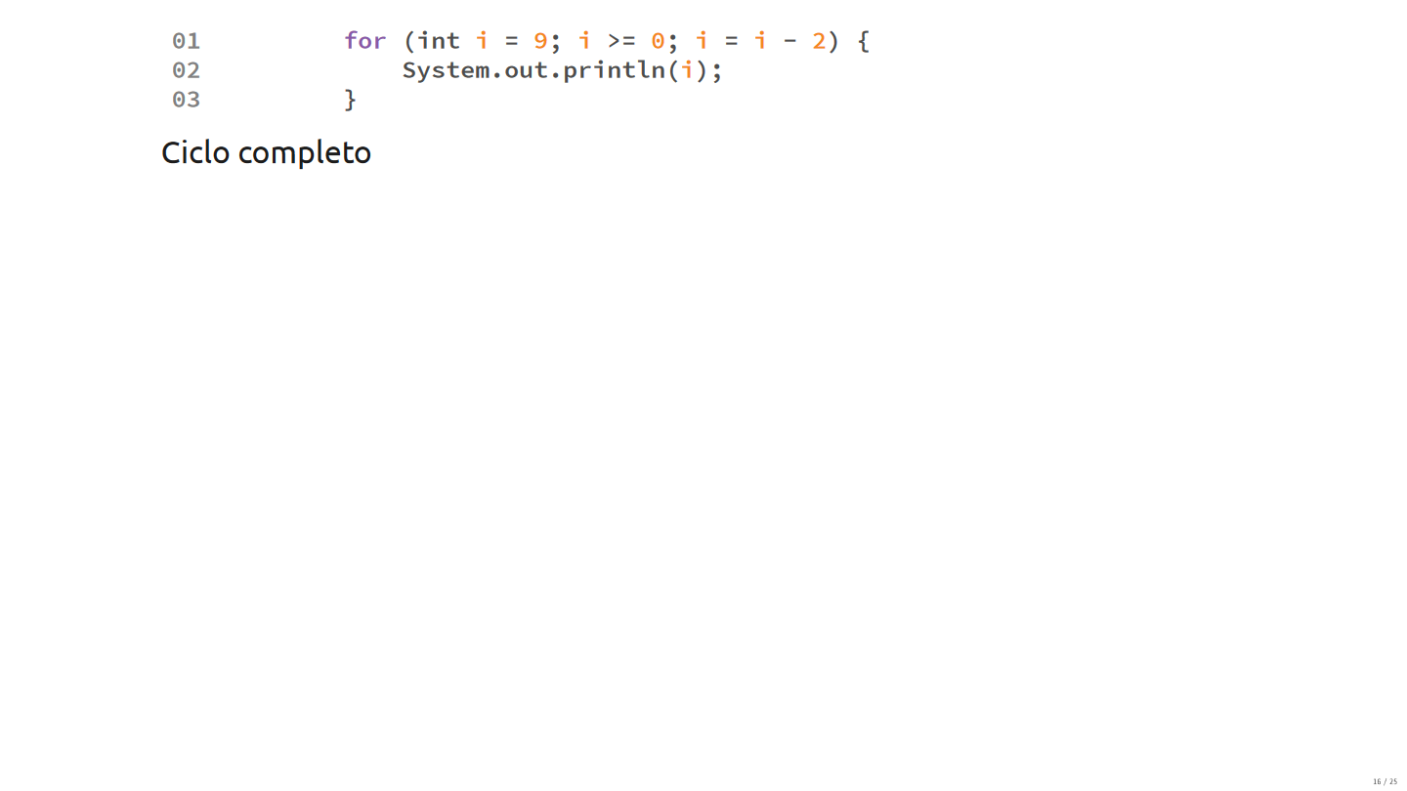

Slide 30
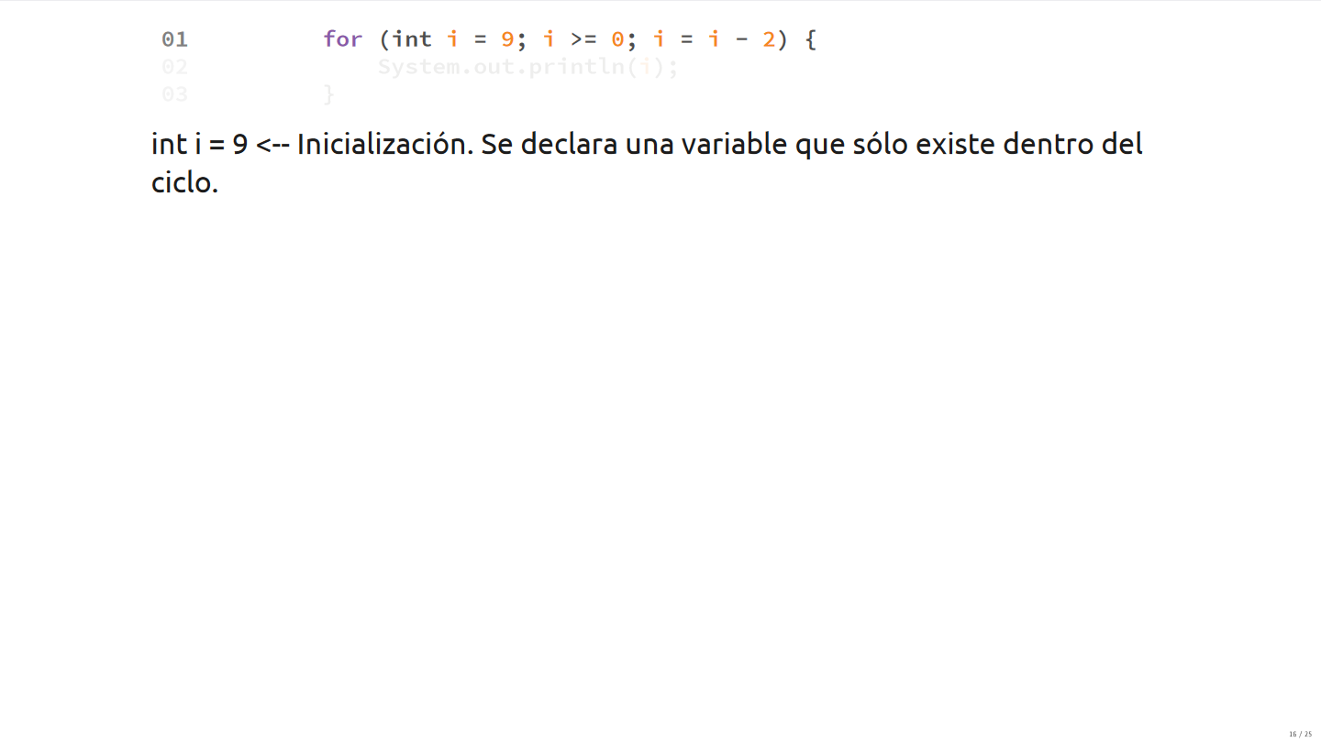

Slide 31
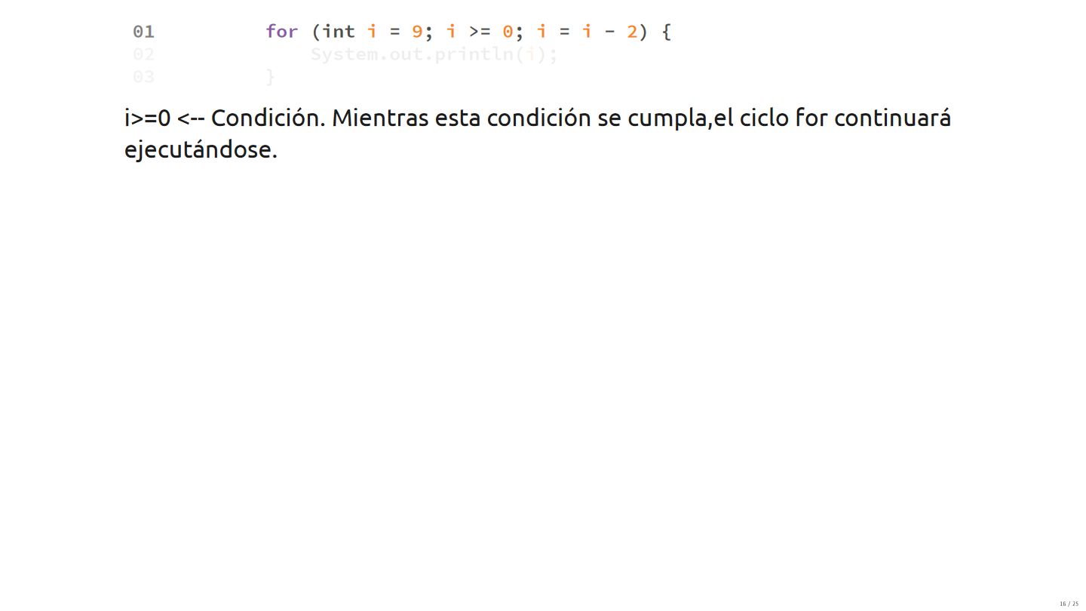

Slide 32
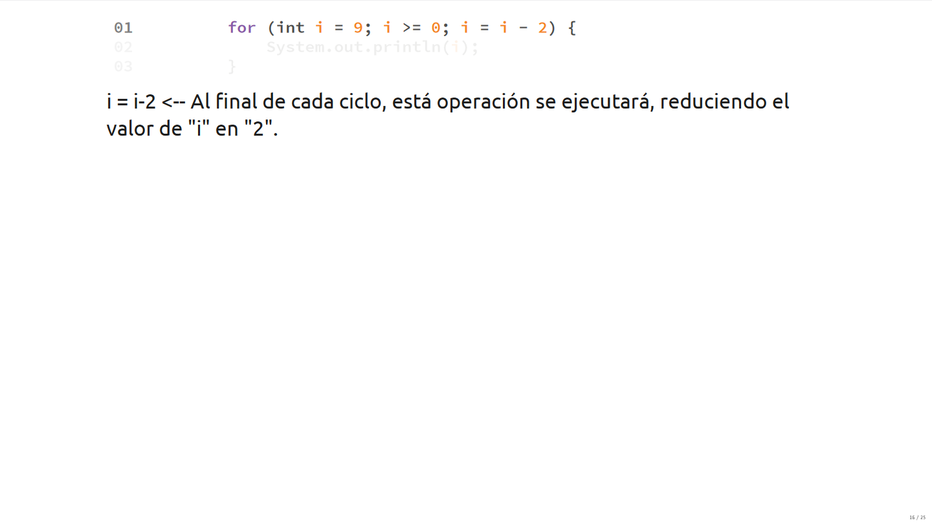

Slide 33
Ejemplo

Slide 34
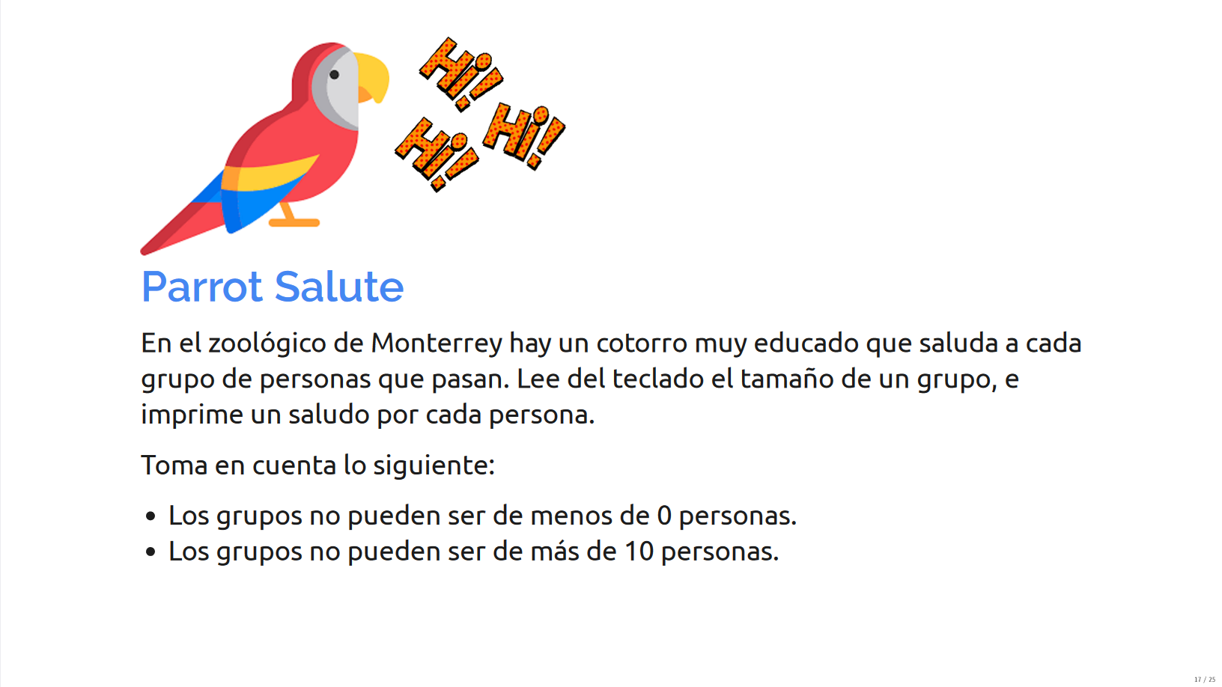

Slide 35
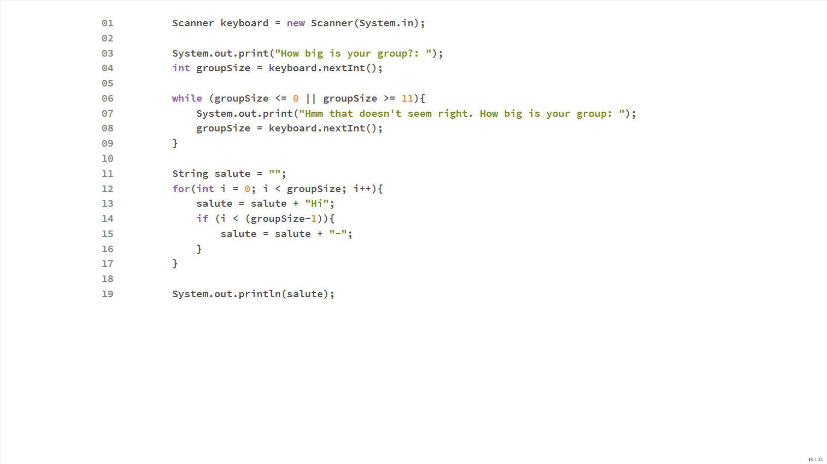

Slide 36
Problemas Comunes

Slide 37
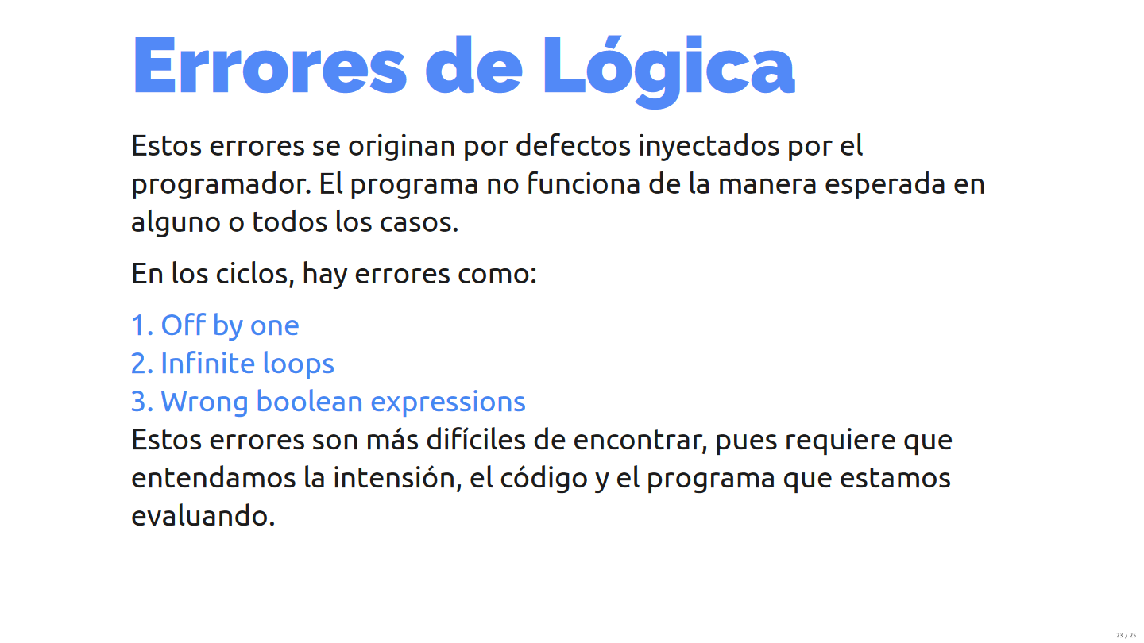

Slide 38
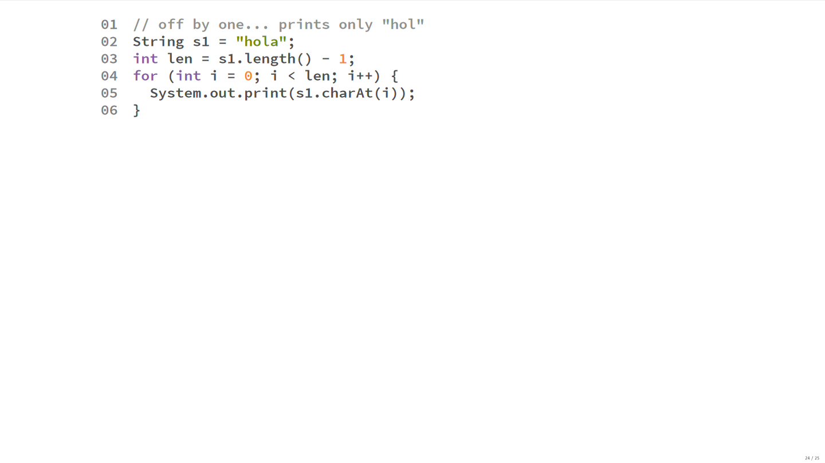

Slide 39
